Slide 1

Data Analysis
( SUPERSTORE SALES DASHBOARD )
Sumit Kumar Sonkar

Slide 2

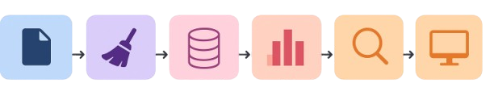
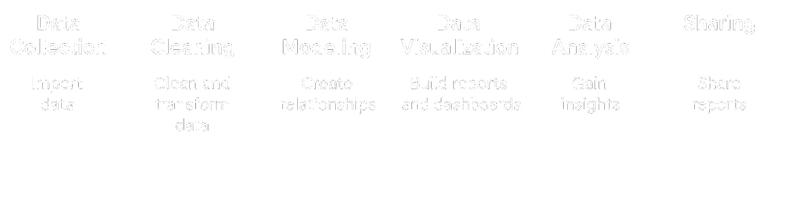
🔍Data Analysis Process

Slide 3
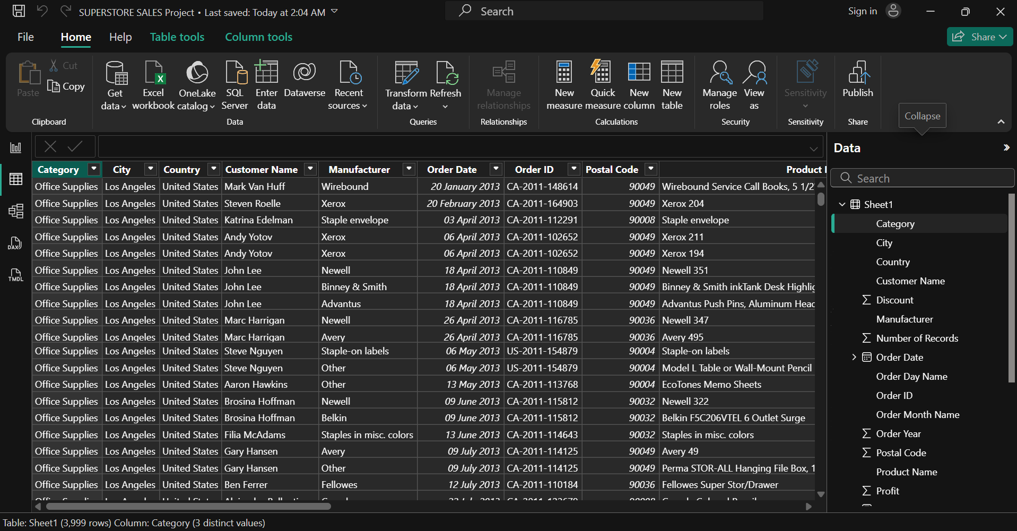

Superstore Sales Data
Total Rows | Total Column
3999 | 24

Slide 4

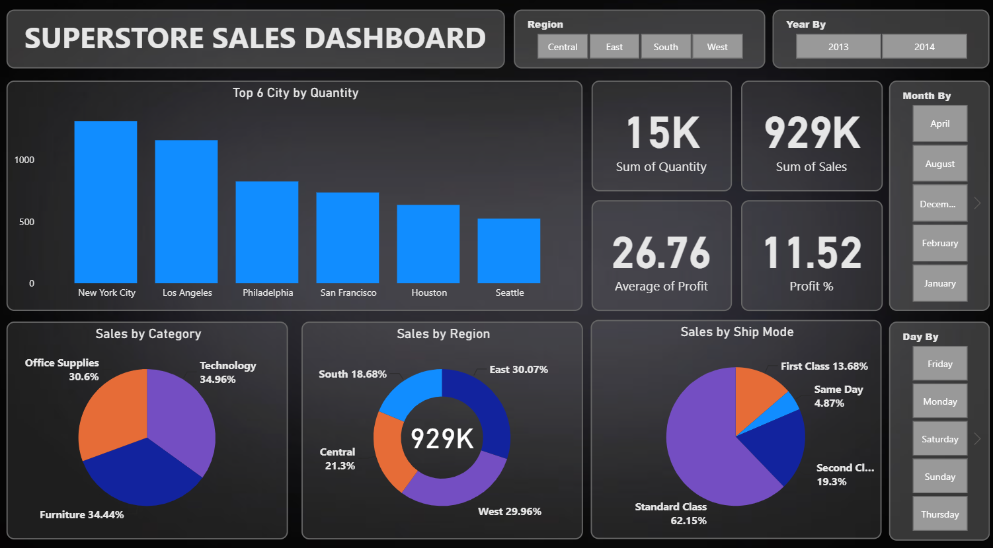
Dashboard - Overview (Page 1)

Slide 5
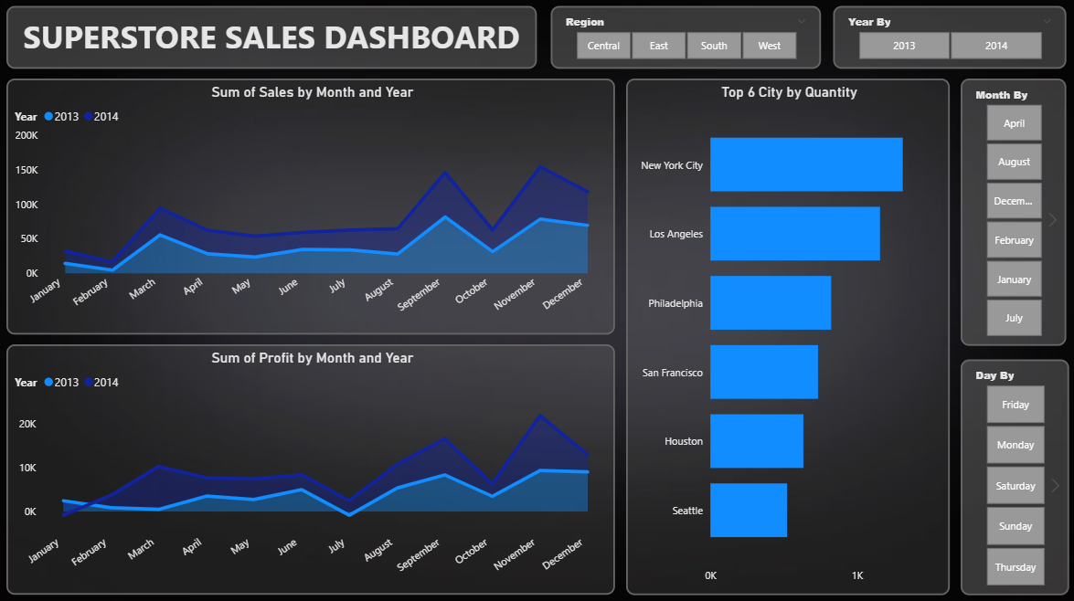
Dashboard - Overview (Page 2)

Slide 6
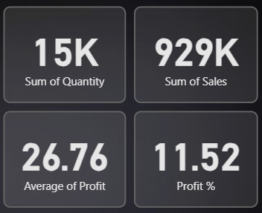
📌 KPI Insights for Slide
Total Product : 1605
Total Quantity : 15K
Total Sales : 929K
Avg Profit : 26.76
Total Profit % : 11.52

Slide 7

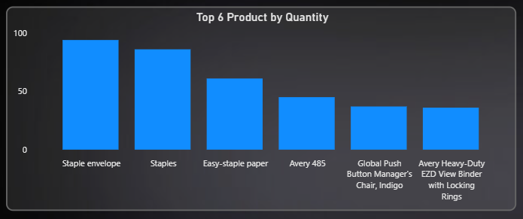
📦 Top-Selling Products by Quantity
Rank | Product Name | Quantity
1 | Staple Envelope | 100+
2 | Staples | ~95
3 | Easy-Staple Paper | ~75
4 | Avery 485 | ~50
5 | Global Push Button Manager's Chair, Indigo | <50
6 | Avery Heavy-Duty EZD View Binder with Locking Rings | <50

Slide 8
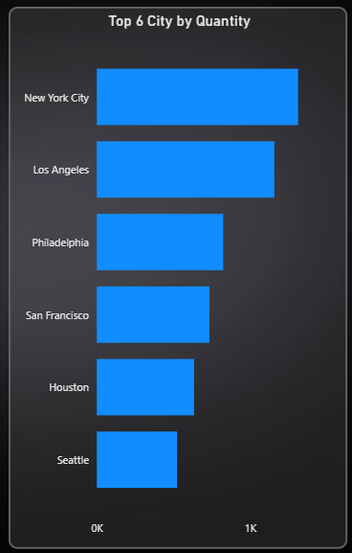
Top 6 Cities by Quantity
Rank | City Name | Quantity
1 | New York City | 1.1K
2 | Los Angeles | 900
3 | Philadelphia | 700
4 | San Francisco | 600
5 | Houston | 500
6 | Seattle | 400

Slide 9
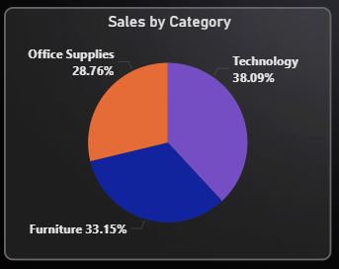
🧩 Sales by Category
🎯 Insight
Technology leads with 38% of total sales, but Furniture and Office Supplies are close contenders, indicating a balanced product mix.
Category | Sales Share (%)
Technology | 38.09%
Furniture | 33.15%
Office Supplies | 28.76%

Slide 10
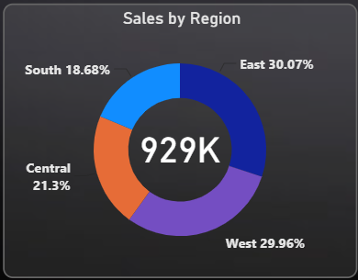
🌍 Sales by Region
🎯 Insight
West and East regions dominate with over 90% of total sales, while Central lags significantly.
Region | Sales Share (%)
East | 30.07%
West | 29.96%
Central | 21.3%
South | 18.68%

Slide 11
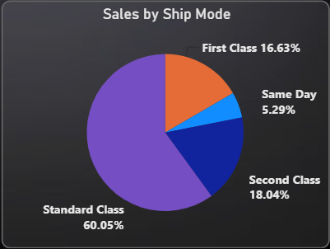
🚚 Sales by Ship Mode
🎯 Insight
Standard Class dominates with 60% of sales, indicating customer preference for cost-effective delivery.
Ship Mode | Sales Share (%)
Standard Class | 60.05%
Second Class | 18.04%
First Class | 16.63%
Same Day | 5.29%

Slide 12
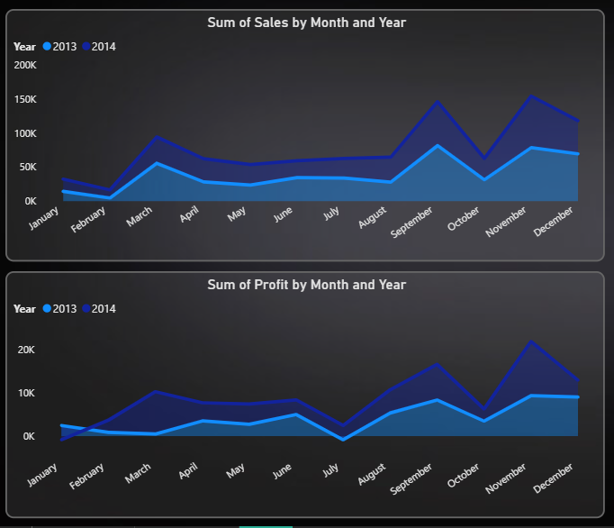

📈 Monthly Sales & Profit Trends
🎯 Insight
2014 consistently outperforms 2013 across most months, with September and November as peak periods for both sales and profit.

Slide 13
Thank You

